Slide 1
MANAGEMENT OF OVARIAN CARCINOMA
Dr Rema.P
Division of Gynecologic Oncology
Regional Cancer Centre
Trivandrum

Slide 2
EPITHELIAL OVARIAN CANCER
Clinical challenge
Asymptomatic
Present in advanced stages
Highest fatality to case ratio

Slide 3
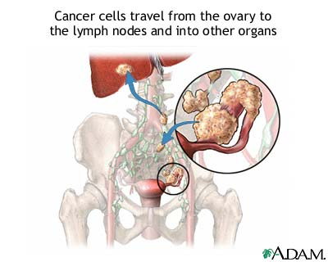

Slide 4
Aetiology
Majority sporadic (90%)
Genetic origin (up to 10%) BRCA1 gene – 40-60 % risk BRCA2 – 10-30% Two or more 1st degree relatives affected HNPCC
Increased risk in nullips, early menarche, late menopause, ovarian stimulation, abnormal ovarian development

Slide 5
Presentation
Asymptomatic
Pelvic mass (diff. diagnosis)
Pressure symptoms/abdominal distension/GI symptoms
Pain
Abnormal bleeding

Slide 6
Diagnosis
Clinical examination
CA-125 & Transvaginal scan/Abd. Scan
Other tumour markers – HE4 CEA, CA 19-9
CT/MRI abdomen & pelvis
Overlap between benign and malignant

Slide 7
CT Scan
To assess primary tumour
Evaluates potential sites of metastasis
Peritoneal implants, lymphadenopathy
To assess spread and resectability

Slide 8
Surgical treatment of early-stage ovarian cancer
Highlights:
Early-stage - has to be defined by a complete tumor clearance and surgical staging
The completeness of surgical staging predicts survival and disease-free survival
The effectiveness of adjuvant treatment in properly staged case

Slide 9
Stage and Survival
Early Stage (Stage I ) - - 5-year survival of 85% to 90%
Advanced disease - 5-year survival - < 50% ( 70% to 80%, recurrence in 12 to 24 months)
Marked difference in survival rates - underscores the importance of comprehensive surgical staging
Complete surgical staging for early ovarian cancers has clear benefits for disease management - FIGO

Slide 10
Surgical staging in Ovarian Cancer
Surgical staging for ovarian cancer –
Peritoneal washings
Peritoneal biopsies
Hysterectomy and salpingo-oophorectomy
Pelvic and paraaortic lymph node dissections
Omentectomy

Slide 11
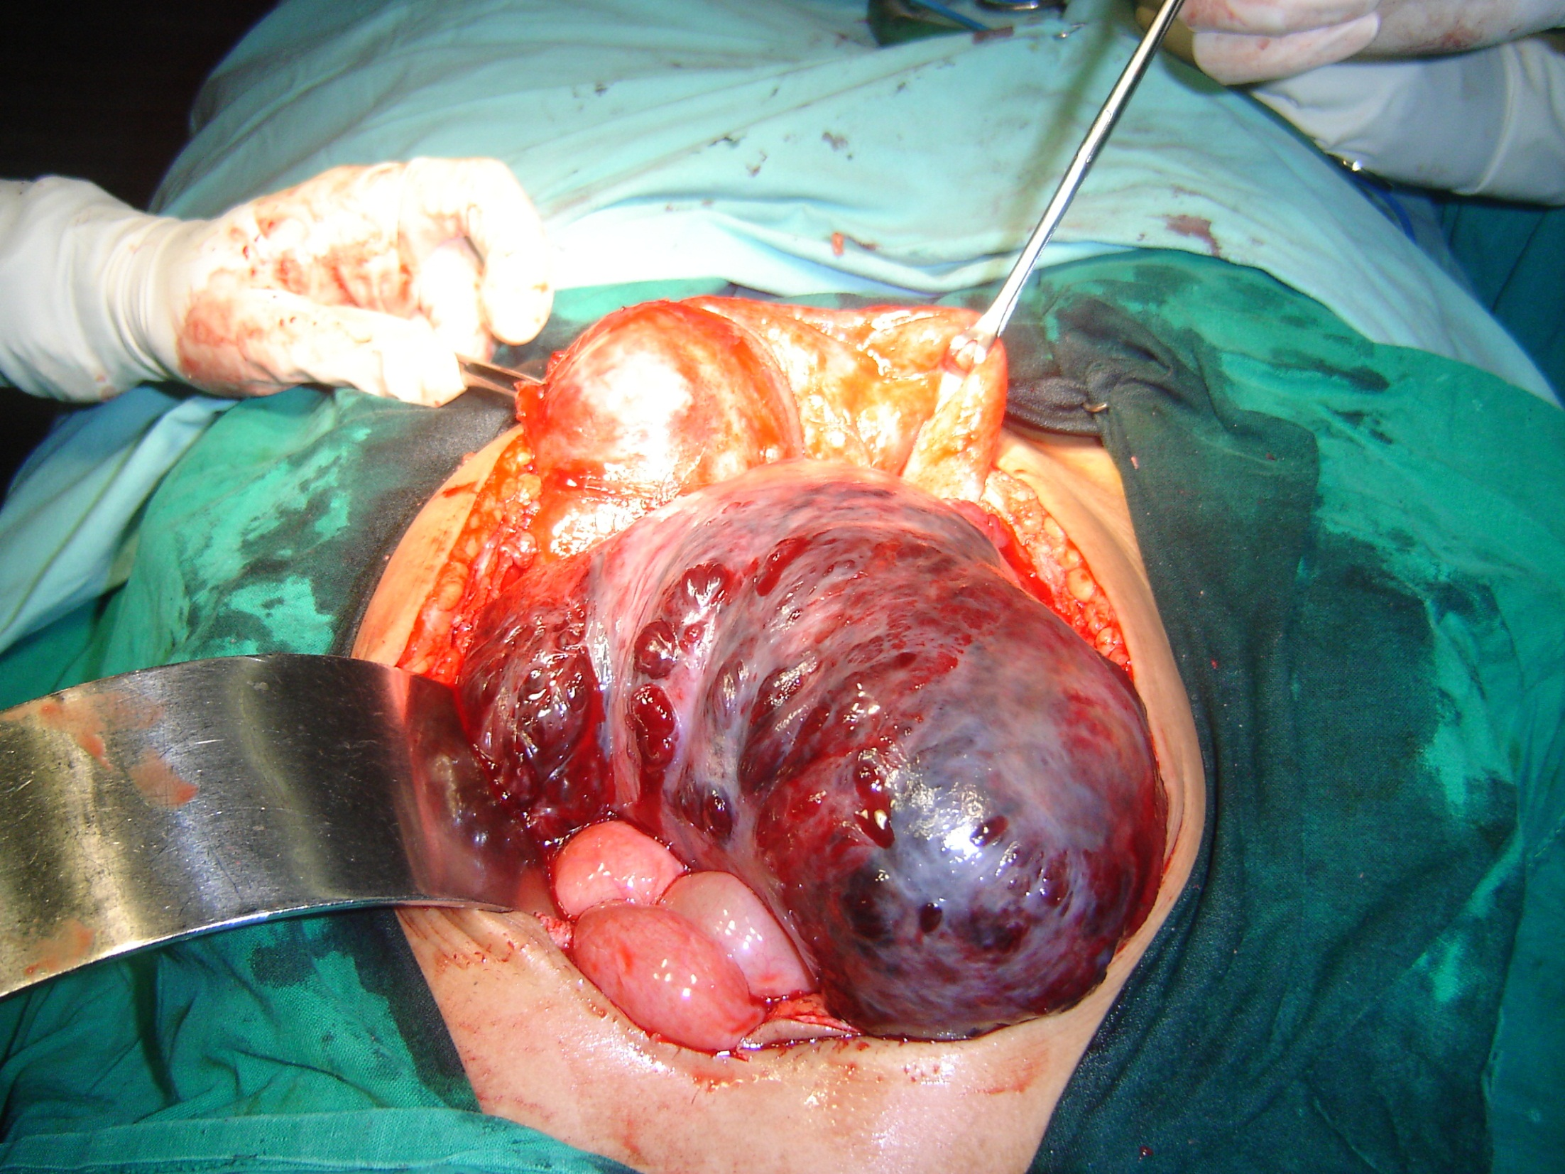

Slide 12
Does rupture during surgery worsen prognosis ??
Higher risk of disease recurrence
Survival in C1 > C2 >C3
Laparoscopy – 25% chance of spill Vs 8% for open
Vergote, J. De Brabanter, A. Fyles, K. Bertelsen, N. Einhorn, P. Sevelda, et al.
Prognostic importance of degree of differentiation and cyst rupture in stage I invasive epithelial ovarian carcinoma
Lancet, 357 (2001), pp. 176–18

Slide 13
Surgical staging- procedure
Incision
Peritoneal cytology
Exploration & biopsies
Frozen section
Hysterectomy, BSO
Omentectomy
Pelvic & Paraaortic LN dissection
Peritoneal biopsies
Appendicectomy

Slide 14
Incidence of mets in apparently normal areas
Positive peritoneal washing |  | 20%
Diaphragmatic peritoneum Bx |  | 7%
Rest peritoneal Bx |  | 10%
Supracolic omentectomy |  | 10-30%
Appendix | Grade ⅔ & mucinous | 23%
Retroperitoneal lymph nodes | More in serous | 5-25%
Cytoreductive surgery in ovarian cancer Christophe Pomela,b, Arjun Jeyarajaha et al Cancer Imaging (2007) 7, 210215.

Slide 15
Lymphadenectomy in Cancer ovary
Lymphadenectomy an essential part of staging and cytoreduction
Stage | Pelvic LN | Para aortic LN
Early | 8% | 15%
Advanced | 55% | 75%

Slide 16
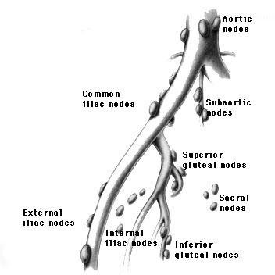
Systematic Pelvic LN dissection
Removal of all fibrofatty lymphatic tissue from the predicted areas of high incidence of metastasis

Slide 17
Ext iliac,Int iliac & Obturator

Slide 18
Para aortic dissection
Limits:
Superior – Renal vein
Inferior – Common iliac
Lateral - Lt Ureter
Medial – Lat border of IVC

Slide 19
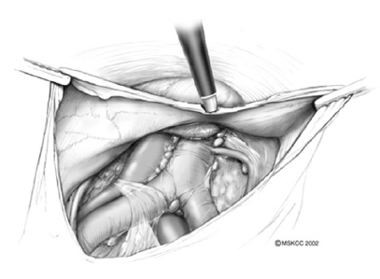
Para aortic dissection

Slide 20
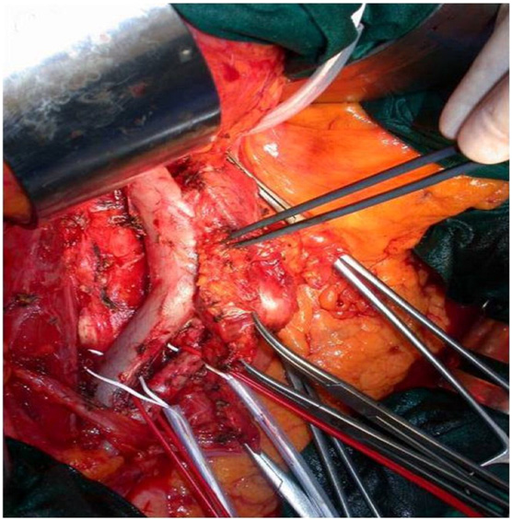

Slide 21
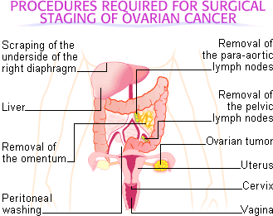

Slide 22
DEBULKING OR CYTOREDUCTIVE SURGERY

Slide 23
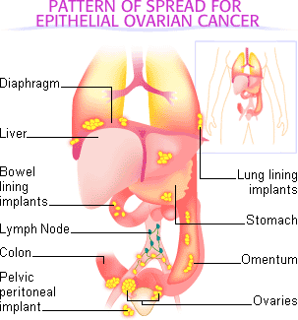

Slide 24
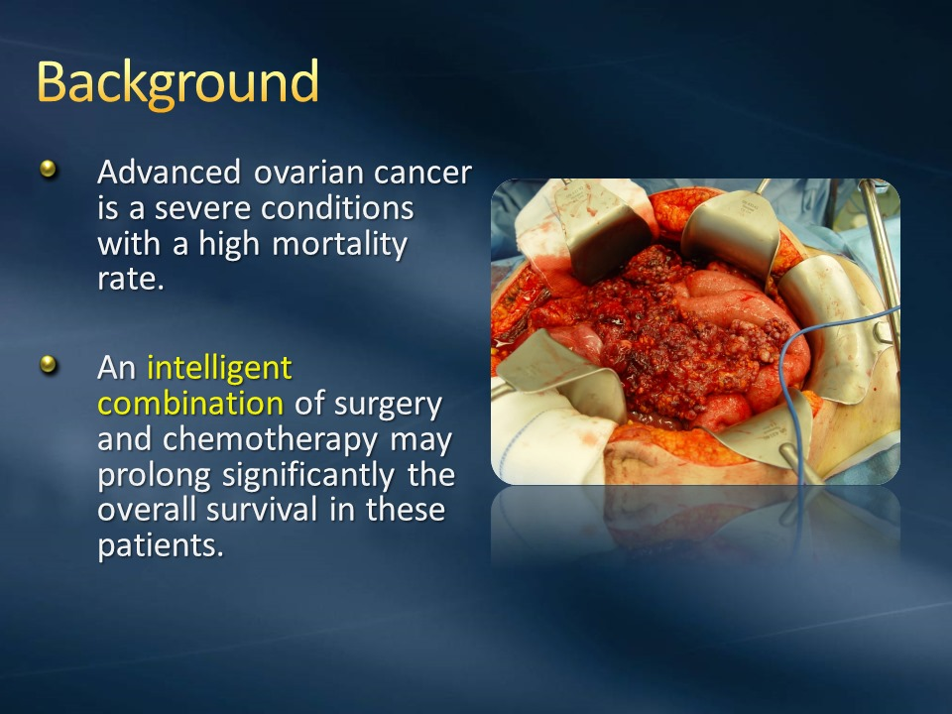

Slide 25
Advanced Ovarian Cancer
Stage II, III and IV
Not amenable for a complete Cytoreduction – No Surgery attempted
Neoadjuvant Treatment indicated
Interval Cytoreduction –
if primarily inoperable
2 – 3 chemo

Slide 26
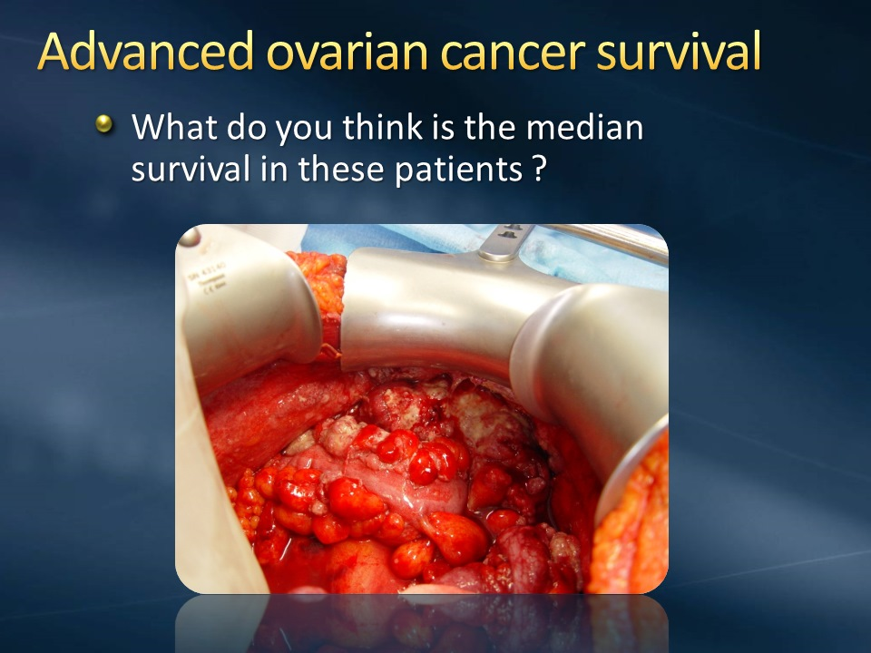

Slide 27


Slide 28
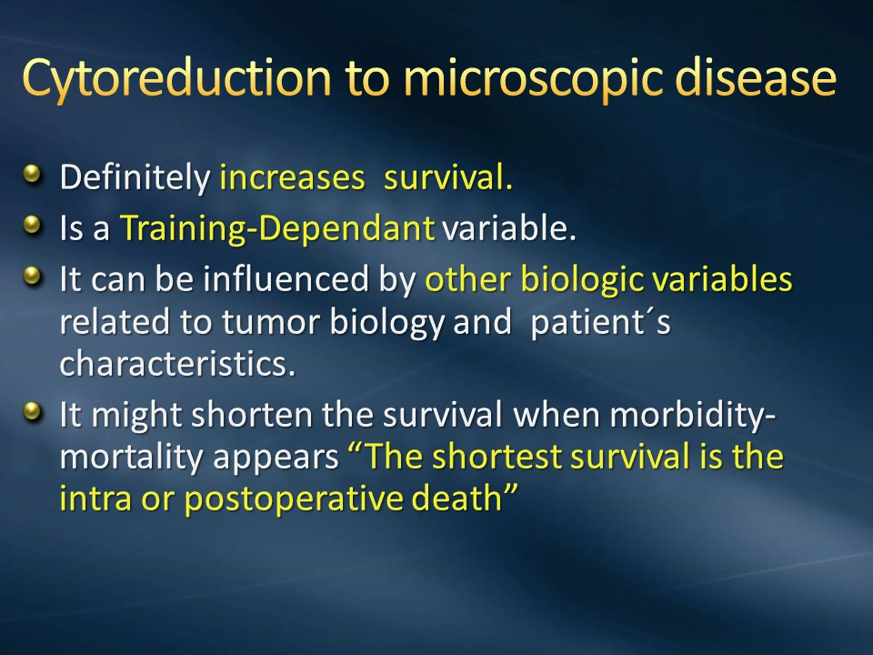

Slide 29
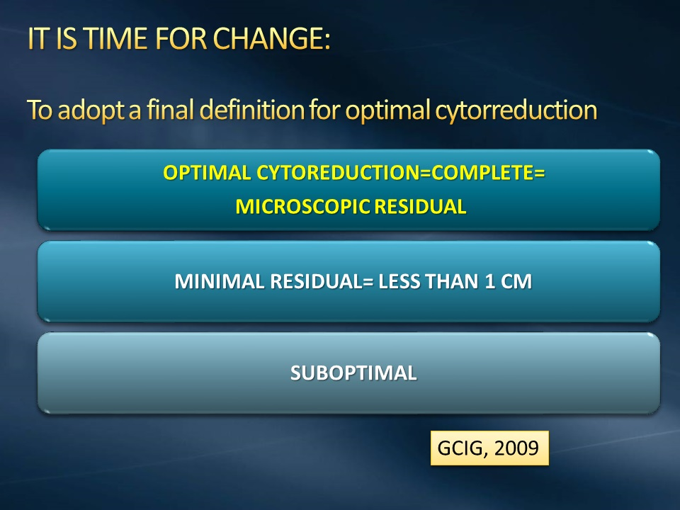

Slide 30
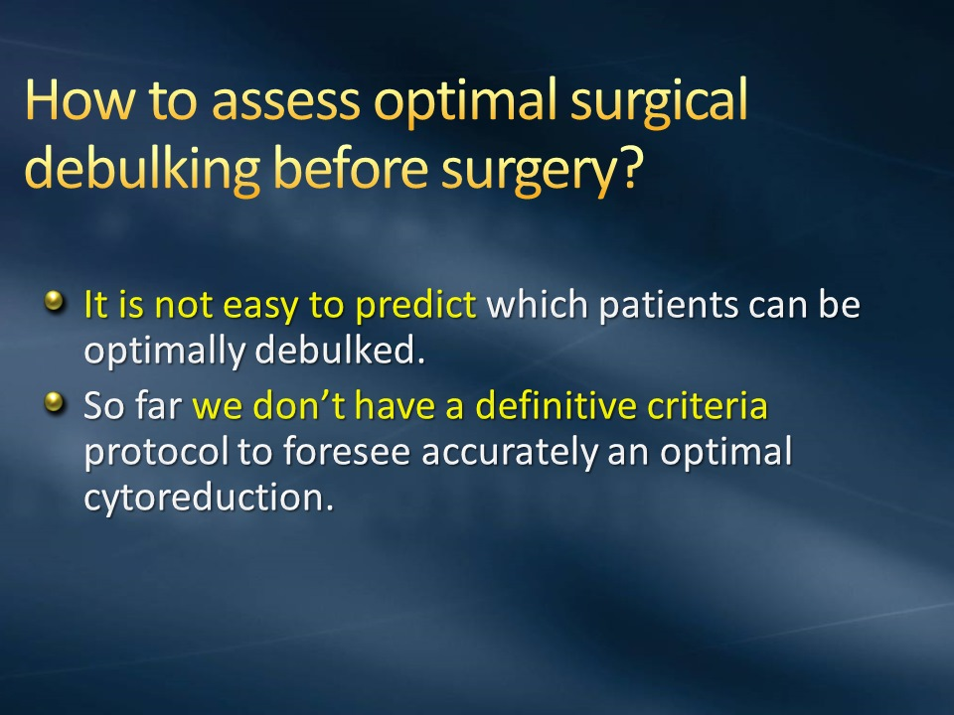

Slide 31
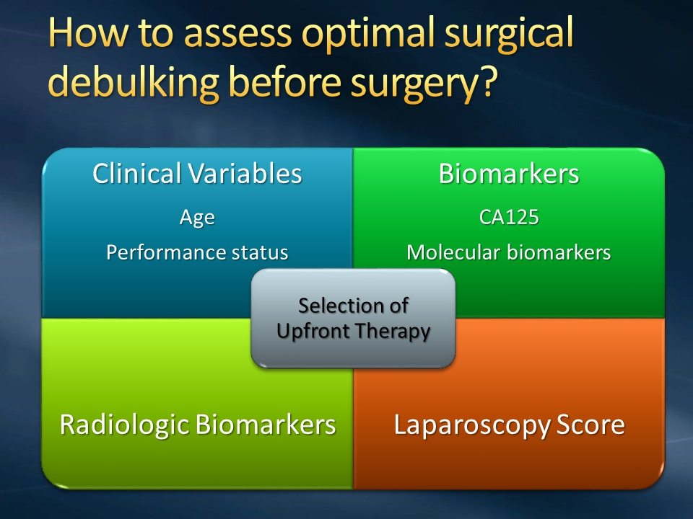

Slide 32
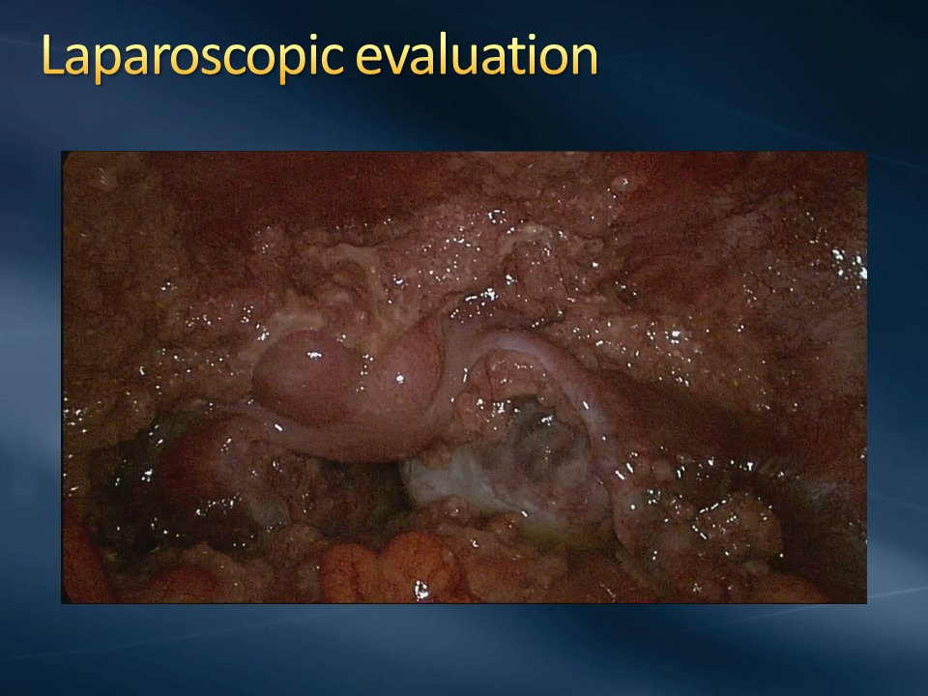

Slide 33
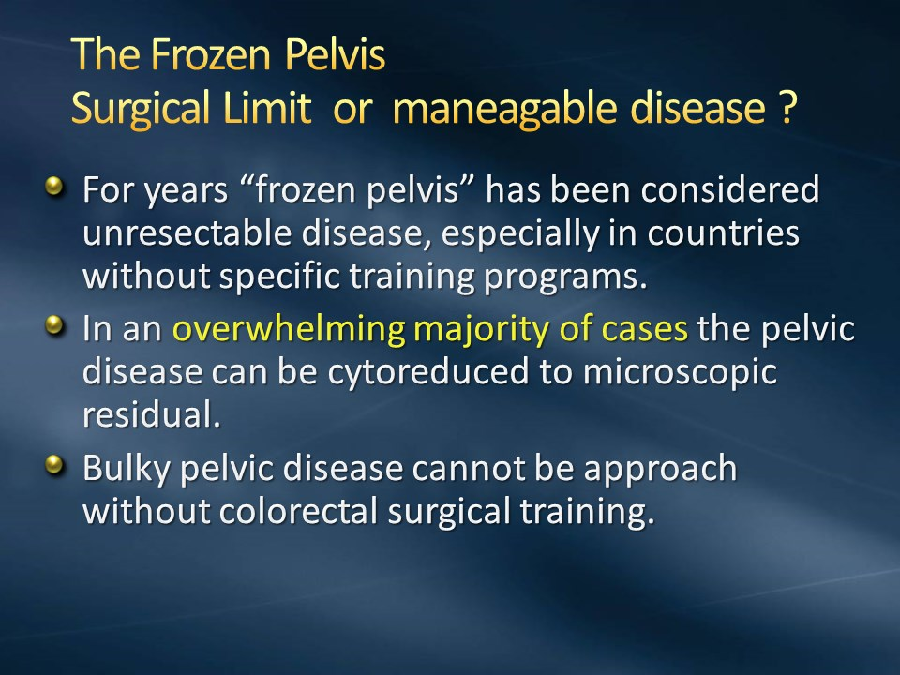

Slide 34
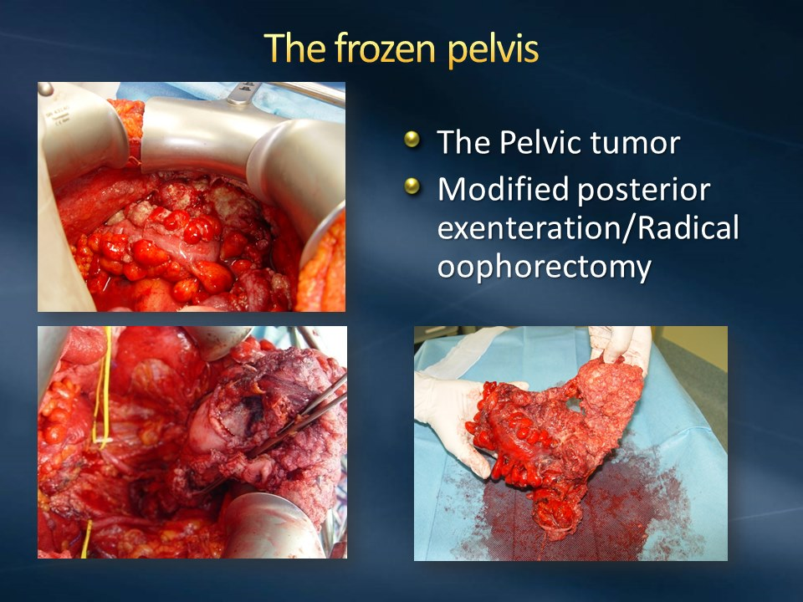

Slide 35
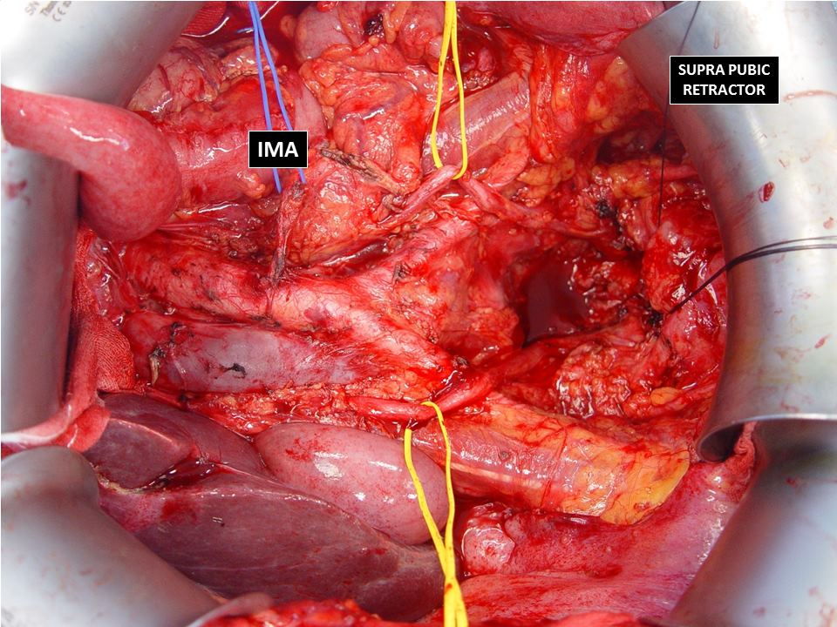

Slide 36
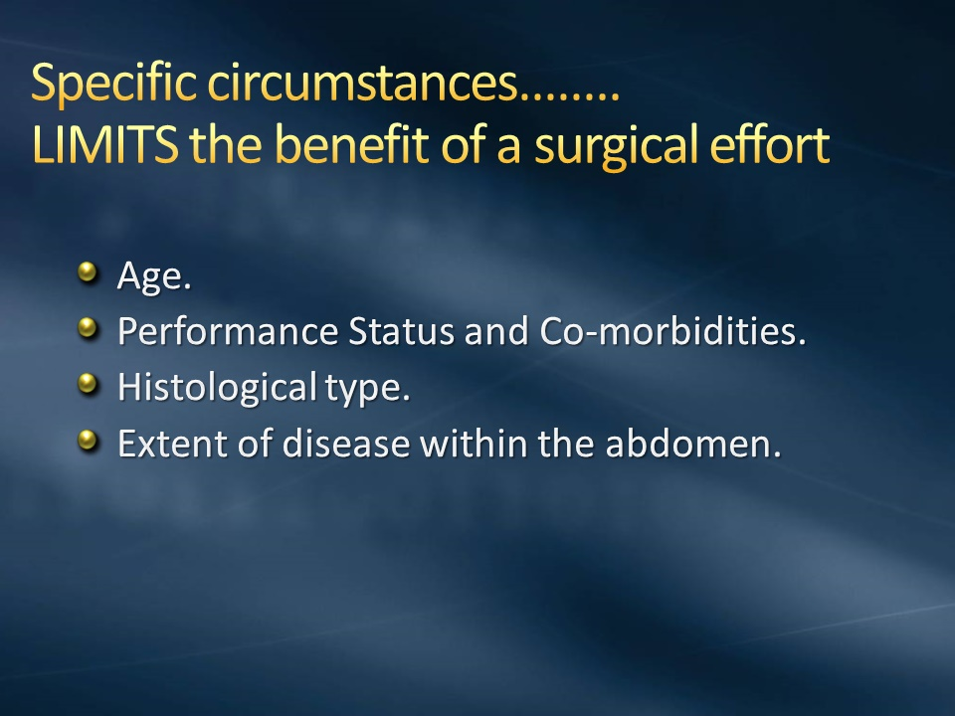

Slide 37
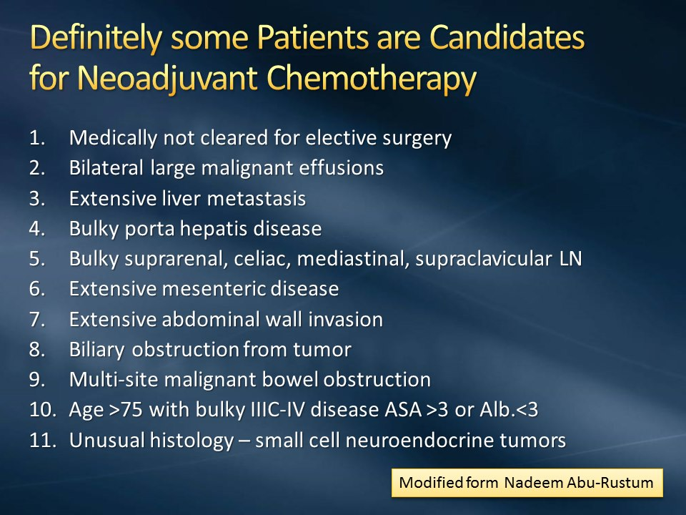

Slide 38
Ovarian cancer risk reduction

Slide 39
RRSO- Risk Reducing Salpingo Oophorectomy
Dual risk reduction
in BRCA1/2 mutation carriers
reduce ovarian cancer risk by 80% to 95%
breast cancer risk by 50% (for premenopausal women)
Role of hysterectomy
Limited data suggest slightly increased risk of serous uterine ca in BRCA1. Discuss risks & benefits of concurrent hysterectomy with RRSO

Slide 40
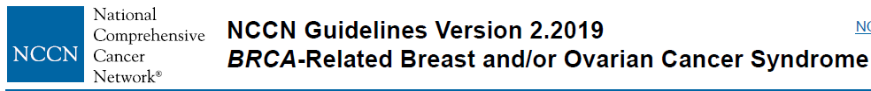
RRSO- typically between 35-40yrs, and upon completion of childbearing
Because ovarian cancer onset in BRCA2 is an avg 8-10yrs later- reasonable to delay RRSO until 40-45 yrs in BRCA2 unless age at diagnosis in family warrants earlier age of consideration of prophylactic surgery

Slide 41
Peritoneal ca risk
∼4% risk of developing primary peritoneal cancer over 20 years
To be informed of the small possibility of primary peritoneal cancer
Screening with TVS+CA-125 to be considered when RRSO not considered
Notes:
Some of these may represent recurrence of occult ovarian
or tubal malignancies that were not recognized at time of initial
pathologic evaluation, emphasizing the need for careful pathologic
evaluation of the entire ovary and fallopian tube at time of
RRSO. It has also been speculated that the peritoneal cancer can
arise from exfoliated tubal cells (endosalpingiosis) that implant
on the peritoneum and undergo malignant transformation in that
location. Lastly, some authors have suggested that peritoneal malignancies
can start exclusively in the peritoneum through mullerian
metaplasia (72).

Slide 42
Opportunistic Salpingectomy as a risk reducing procedure

Slide 43

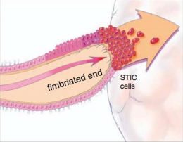
Origin of high grade ovarian cancer
Serous tubal intra epithelial carcinoma (STIC)is the precussor of HGSC, primary fallopian and primary peritoneal
Piek JM, van Diest PJ, Zweemer RP, Jansen JW, Poort-Keesom RJ, Menko FH,et al. Dysplastic changes in prophylactically removed Fallopian tubes of women predisposed to developing ovarian cancer. J Pathol 2001;195(4):451–6.

Slide 44
Opportunistic Salpingectomy as a risk reducing procedure
Among general (Low) risk population
BritishColumbia (BC) ovarian cancer prevention initiative.
TH with Bilateral salpingectomy(BS)
BS for permanent sterilization
Projected 40% reduction in ovarian cancer rates in the province over next 20 years

Slide 45
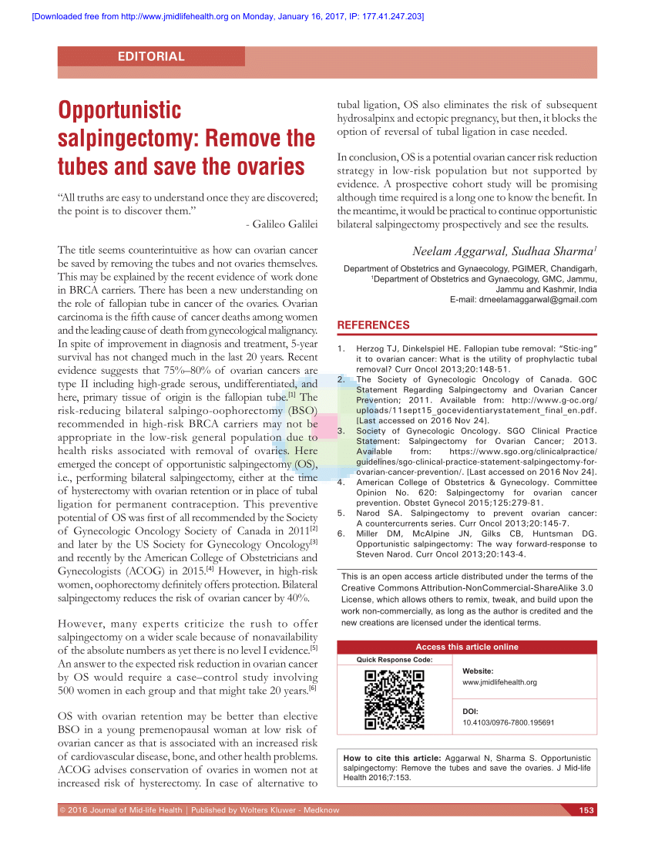

Slide 46
Cancer ovary - summary
Comprehensive surgical staging gives excellent cure rates in early ovarian cancer
Surgical cytoreduction for advanced ovarian cancer for maximum patient survival
RRSO for BRCA patients
Opportunistic Salpingectomy as a risk reducing procedure

Slide 47
Thank you…
Thank you

